Slide 1

XenoBase.io
DESIGNED BY:
DYLAN GNATZ,
DIEGO HOYOS,
& TOM BRADY

Slide 2
Mission Statement
Cryptocurrencies and blockchain technology have immense potential to revolutionize how data is stored and contracts are facilitated on the web. To model this emerging field of ecommerce, we are constructing a simple blockchain based currency, called XenoCash (XENO), and an online trading hub for it, XenoBase.io. Registered users on XenoBase can exchange USD and XENO between wallets. When transactions occur across the XENO blockchain, transaction information will be pushed to the XenoBase MySQL database. This data can be utilized to compute the current average price of the currency and to visualize price trends over time, as well as to keep track of our registered users and the trading volume of XENO.

Slide 3
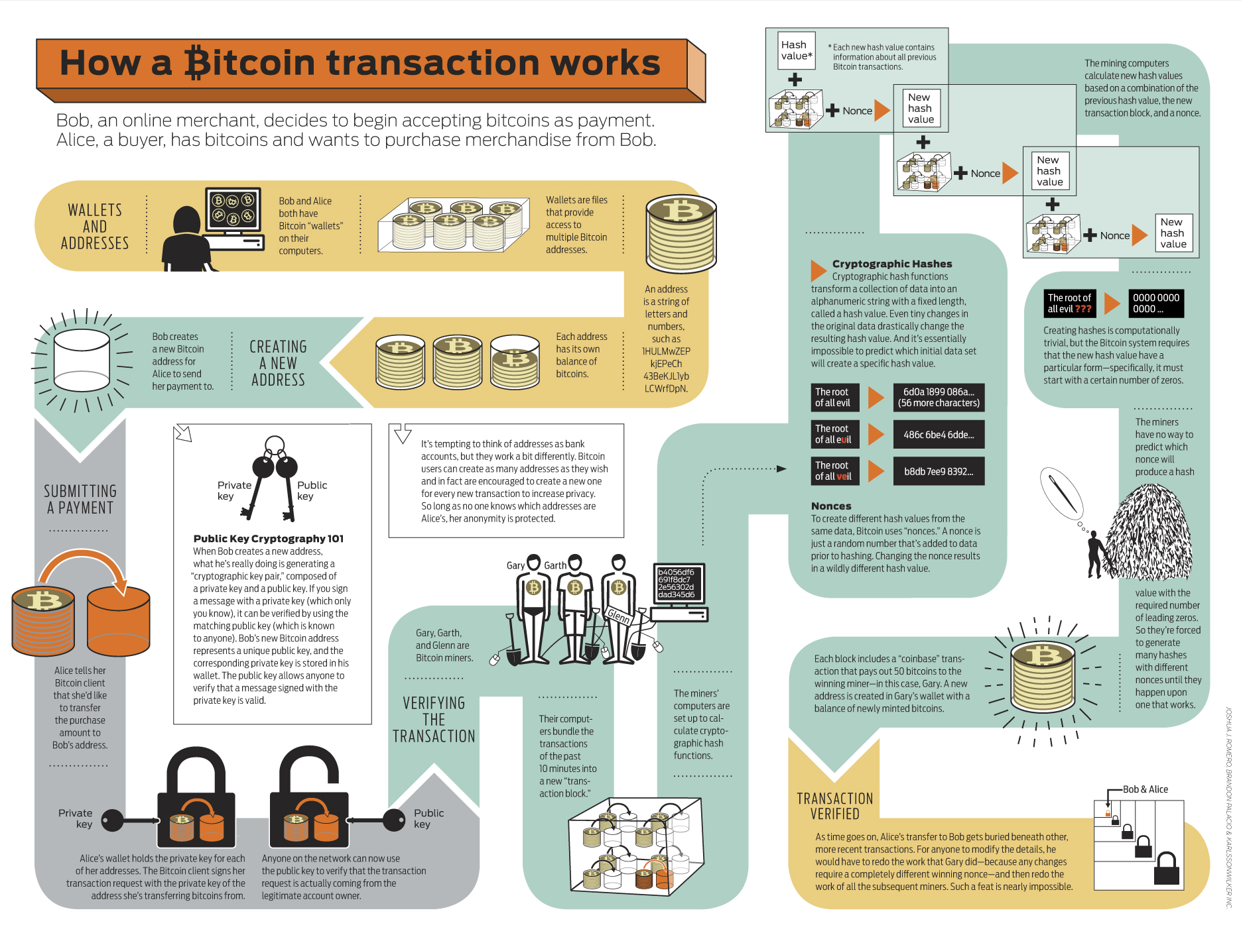

Slide 4
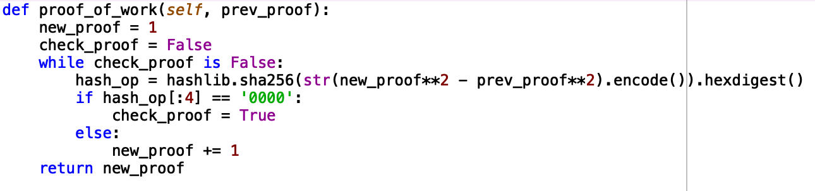
Mining Algorithm (Sha-256)

Slide 5
Relational Database Overview

Slide 6
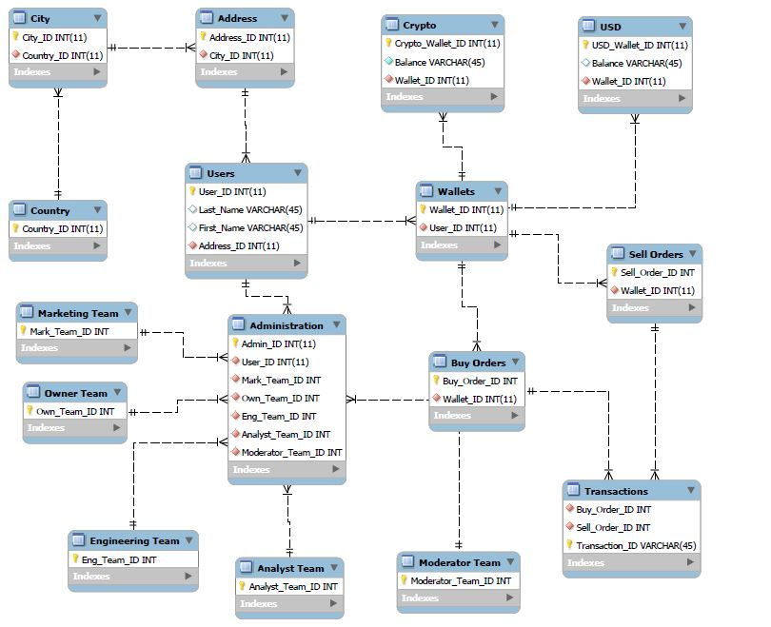
Conceptual Model

Slide 7
Application Architecture

Slide 8
Summary
XenoCash blockchain built in Python.
Flask app to accept HTTP requests for the Blockchain.
Postman used to create and save HTTP requests, interact with XENO blockchain.
MySQL Connector to XenoBase schema allows blockchain actions to update and query the XenoBase database.

Slide 9
Overview: Actions
When a user wants to buy/sell XenoCash
User creates a buy-order/sell-order respectively
The application matches buy-orders to sell-orders based on multiple criteria (i.e. price, amount, order, etc.)
The match is logged and a transaction generated from the buy and sell orders
The transaction is pushed the to blockchain
The transaction is included in the next block to be mined by a node
The application updates the wallets of the buyer/seller accordingly

Slide 10
Queries
﻿Adds a new transaction -- returns the transaction ID (params buy_order_ID, sell_order_ID)
﻿Updates status of transactions to mined once a block is added to the chain.
﻿Returns the wallet associated with a sell order. (param sell_ID)
﻿Returns the wallet associated with a buy order. (param buy_ID)
﻿Returns the XENO and USD amounts associated with a sell order (param sell_ID)
Returns all unfulfilled buy orders where the XENO/USD price is under a certain amount. (param price)

Slide 11
Queries
7. ﻿Returns the average price per XENO of all unfulfilled sell orders.
8. ﻿Returns all unmined transactions
9. ﻿Returns a list of buyers ordered by the number of transactions they have participated in.
10. ﻿Returns a list of users based on a common city_ID (param city_ID)

Slide 12
DEMONSTRATION

Slide 13
Questions?

